Slide 1
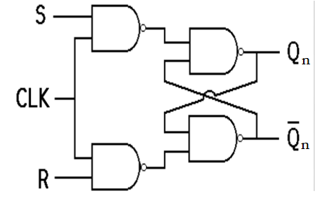

Clock Triggering: Positive edge negative edge positive level negative level

Slide 2
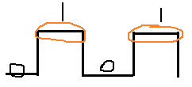

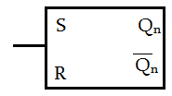
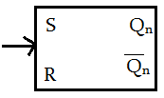
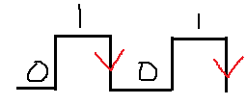
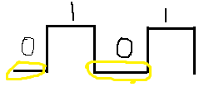
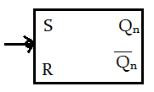
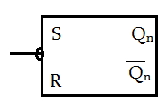
Level triggering Edge triggering
+ ve level +ve edge
- Ve level - ve edge

Slide 3
Flip Flop Conversion
Steps :
Identify available & required FF
Make Excitation table for available flip flop.
Make Characteristic table for required flip flop.
Write Boolean Expression for available FF.
Draw a circuit diagram.

Slide 4
1. JK to T FF
Step 1 : available FF = JK
required FF = T
Step 2 : Excitation Table for JK
Step 3: Characteristic table for T FF
Q_{n} | Q_{n+1} | J | K
0 | 0 | 0 | X
0 | 1 | 1 | X
1 | 0 | X | 1
1 | 1 | X | 0
Q_{n} | T | Q_{n+1}
0 | 0 | 0
0 | 1 | 1
1 | 0 | 1
1 | 1 | 0

Slide 5
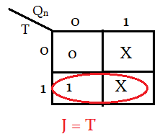
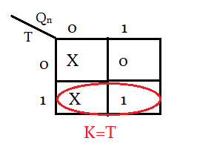

Step 4: Boolean Expression for available FF
For J For K
Q_{n} | T | Q_{n+1} | J | K
0 | 0 | 0 | 0 | X
0 | 1 | 1 | 1 | X
1 | 0 | 1 | X | 0
1 | 1 | 0 | X | 1

Slide 6
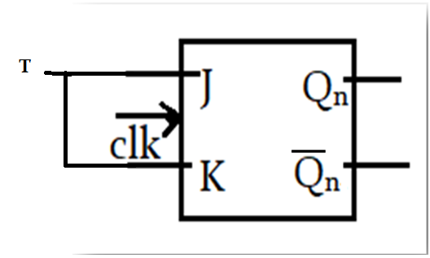
Step 5: Draw a circuit diagram

